Slide 1
Yolov4 object detection

Slide 2
Why Yolov4
R-CNN & Fast R-CNN
1. Though very accurate but slow. Runs 2000 times on the same image.
Yolo models
1. Have good accuracy & very fast.
2. Introduces skip connection (like Resnet) in yolov3 & v4, Can detect small objects (Darknet53)

Slide 3
Use Cases
1. Pizza on conveyor belt: Original Darknet weights
2. Tire on Conveyor belt
3. Defective cup detection

Slide 4
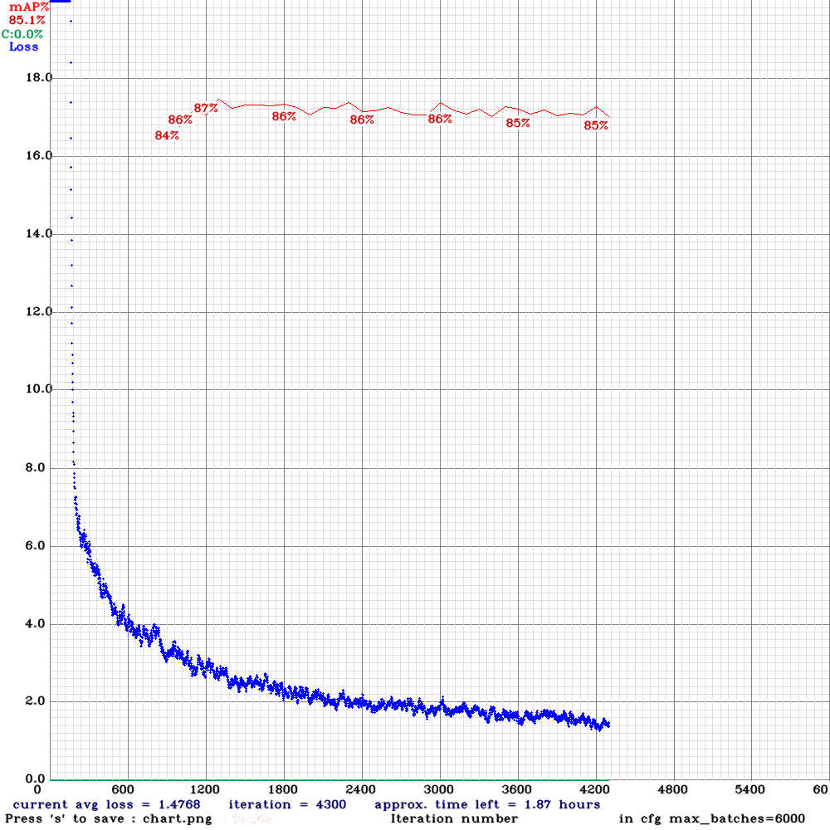
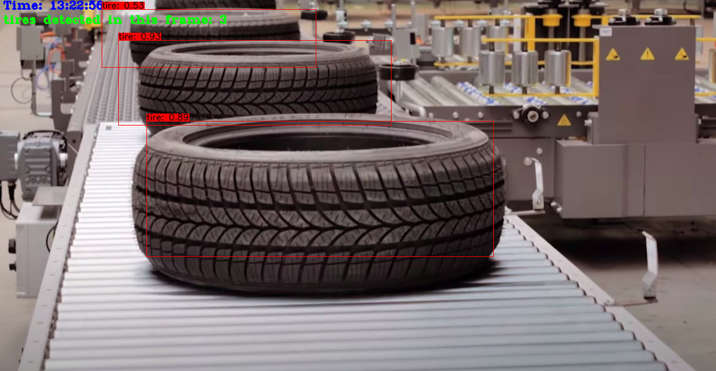
Tire
1. Downloaded 1500 tire images from
Google images dataset
2. Trained upto 4000 epochs.

Slide 5
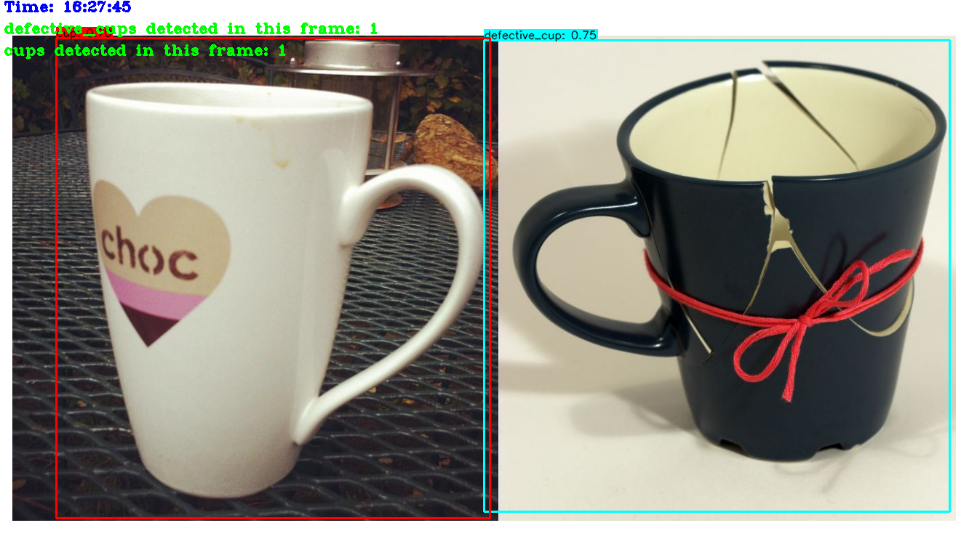
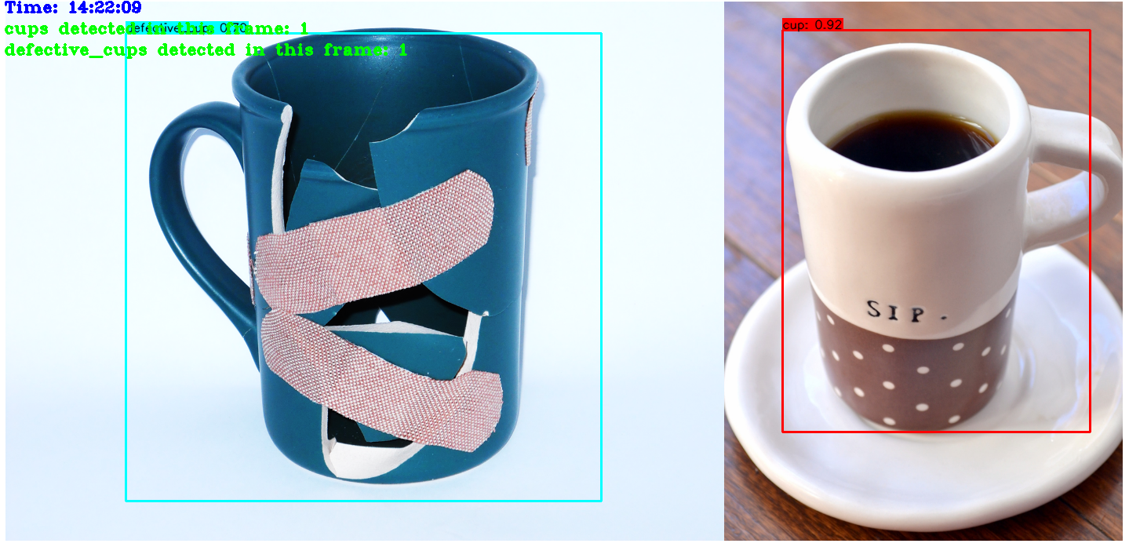
Defective Cup
1. Downloaded 300 good &
defective cup images, manually
labeled
2. Trained for 2 classes up to
4000 epochs.
3. Reduced loss below 2,
And mAP over 85%.

Slide 6
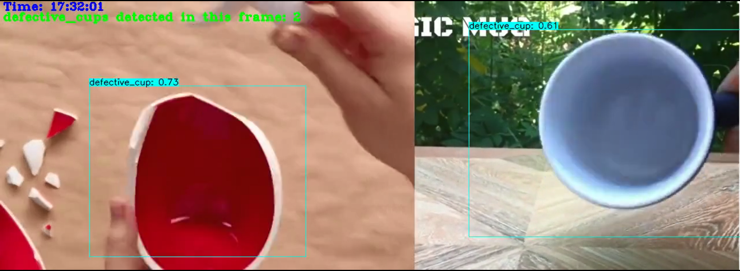
False Positive
False positive (good cups identified as broken cups): if cups kept upside down, or the
Handle not visible then it thinks as broken.
How to reduce: tuning threshold, training with specific use case images.
Usually false negative (broken cups identified as good cups) cases are more critical. Thankfully, false negatives are very low in my predictions.

Slide 7


